Slide 1




SOUTH SUDAN MESP RESILIENCE BASELINE SURVEY
Source: Pibor picture from By Олег Сокол, CC , October 2, 2012
Summary of Findings
December 14, 2021
This presentation was produced for review by the United States Agency for International Development. It was prepared by Management Systems International, A Tetra Tech Company AID-I-668-13-00001, Task Order # 72066819F00002.
Notes:
Image source: By Олег Сокол, CC BY-SA 3.0, https://commons.wikimedia.org/w/index.php?curid=56145814

Slide 2
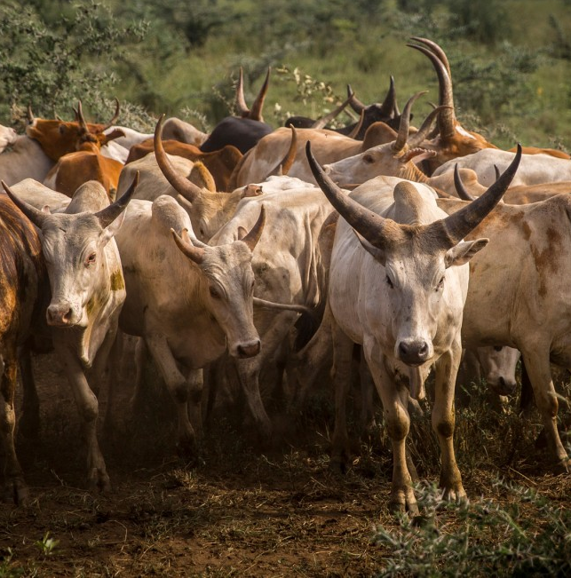
AGENDA
Purpose
Key Takeaways
Methods
Findings
Discussion
Source: S. Sudan cattle picture by ICRC.
Notes:
Image source: ICRC https://www.icrc.org/en/document/south-sudan-where-wealth-counted-cattle-not-cash

Slide 3


PURPOSE
Obtain baseline data in the target areas for the indicators included in the Mission’s PMP. (Household Survey SOW, March 2021)
Conduct additional analyses to help provide a deeper, expanded understanding of the survey results (Expanded Household Survey Exploratory Analysis, Sep 2021)

Slide 4
Household Survey Expanded Analysis
key themes:
Food Security
Agency
Social Cohesion
Shocks and Stresses
Social Norms
Create additional indicators relating to resilience capacities
Examine variation across county, locality, head of household sex
Examine correlations between measures of resilience capacities and contextual outcomes such as shocks, conflict, or well-being
Model relationship between resilience capacity and a) perceived ability to recover from shocks, and b) food security
Notes:
Why the 13 counties – these are USAID priority areas
13 counties selected – as described by USAID report Strategic Framework S. Sudan
“Community (Geographic) Focus The strategy identifies CFAs where USAID/South Sudan will pursue intense coordination, layering of activities, and community engagement. [Note: In this document, “CFA” is used often interchangeably with “county,” but at times refers to a sub-county “targeted area.” Therefore, during implementation we will not refer to CFAs, but use the terms counties, payams (the first administrative division below county in South Sudan), and bomas (the administrative division below payams in South Sudan). In the 13 counties indicated in this document, and during implementation, we will choose some payams as “targeted areas.” “
“The Mission used a number of criteria to select these areas, including but not limited to: historical food insecurity, as measured most recently through the Integrated Food Security Phase Classification system; presence of Community Engagement Centers, a USAID-supported asset that facilitates community engagement; likelihood to attract returns; urban centers that represent an opportunity for economy of scale and private sector engagement; and whether USAID humanitarian assistance awardees would be active in the area. In selecting the CFAs, the Mission also ensured that they included areas at risk of conflict; and that the areas were spread among the different regions of the country to avoid concerns over ethnic favoritism. “

Slide 5
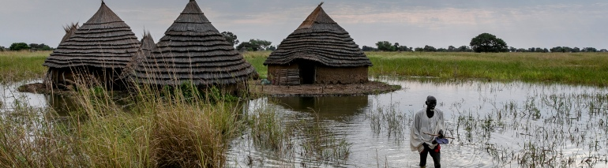
KEY TAKEAWAYS
Source: field of sorghum, which fed his family, is under water [Adrienne Surprenant/AP Photo] Aljazeera report December of 2021.
Notes:
Photo source: https://www.aljazeera.com/news/2021/10/22/flooding-called-worst-thing-in-my-lifetime-in-south-sudan

Slide 6
KEY TAKEAWAYS
Resilience model is validated – increases in resilience capacity associated with improvements in well-being outcomes (ability to recover from shocks, food insecurity)
Incorporate food security as a PMP indicator as a better outcome measure than dietary diversity
Incorporate coping strategies into future data collection
Resilience capacities (agency, cohesion, informal safety nets) could be considered a form of coping strategy
Future studies could explore variation across county, disparities in bonding and bridging social capital, coping strategies, alternative dispute resolution
Ongoing and future USAID programming efforts could include education, social norms, informal safety nets

Slide 7

METHODS
Sampling design and data collection
Limitations

Slide 8
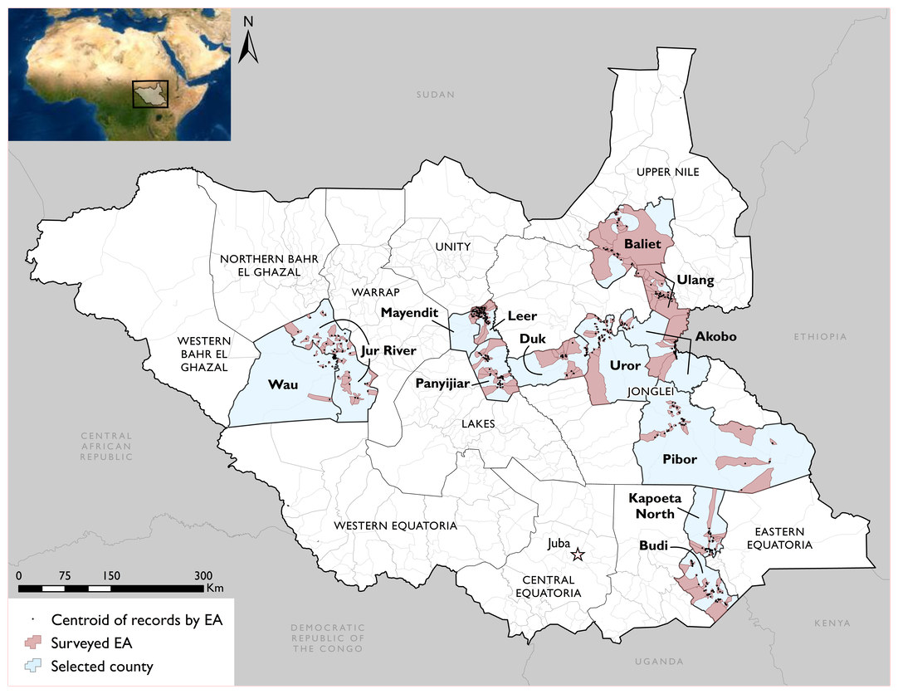
SAMPLE
13 counties
476 EAs
7,872 Total Number of Household Surveys
96% Overall Response Rate
Notes:
Target was 481 EAs
Target was 8,177 HHs

Slide 9
DATA COLLECTION
Translation into 16 languages
Two phases of data collection in 2021
Phase 1 – 6 counties (April)
Phase 2 – an additional 7 counties (November)
249 enumerators in the field
33 supervisors in the field
Steps in Field Data Collection Prep:
Refresher training for supervisors
Recruitment & training of enumerators (17/County)
Recruited field guides and escorts as needed
Household listing and systematic sampling
Interviews in the EAs
Notes:
249 enumerators, 102 in Phase 1 and 147 in Phase 2.
33 supervisors in total, 12 in Phase 1 and 21 in Phase 2.
In Phase 1 we had 17 enumerators and 2 supervisors in each of the 6 counties, while in Phase 2 we had 21 enumerators and 3 supervisors in each of the 7 counties.
Modes of transport included walking, boats and canoes, and car hires.

Slide 10
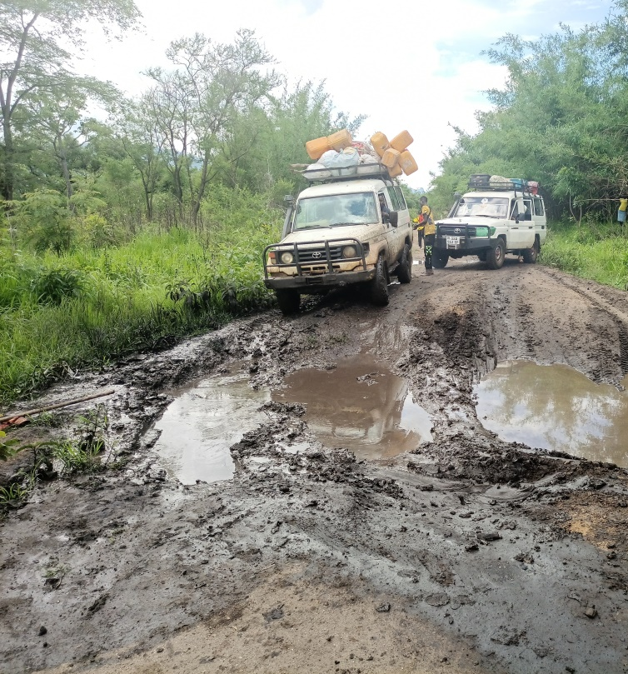
Field Data Collection GETTING TO HOUSEHOLDS
Cars/boats and other modes of transport
Rough terrain/washed out roads
Empty EAs
Security – escorts, sheltering in place, travel at night, SAT phones, SRMA
Locating EA boundaries – overlayed maps with satellite imagery, geofencing on tablets
Syncing of data – paused data collection, leveraged IP support
Source: S. Sudan MESP field data collection in Budi county, June 2021.
Notes:
MESP picture: Road conditions in Budi county, June 2021

Slide 11



HOUSEHOLD CHARACTERISTICS
5 people
1 child < 5
3 children < 18
28% literacy
65% engage in crop farming
Age | 0 to 9 | 10 to 19 | 20 to 29 | 30 to 39 | 40 to 49 | 50 to 59 | 60 +
Percent | 28% | 29% | 16% | 10% | 8% | 5% | 4%
Notes:
Education is people over 6 years of age
Remaining 3% is tertiary education
Literacy is self-reported, so actual level of literacy could be lower
Economic activity is people over 10 years of age
73% of people are under 30
Average age is 21
USAID Youth Categories: https://www.usaid.gov/sites/default/files/documents/Formatted_508_Draft_for_Public_Comment_USAID_Youth_Policy_Update_2021_1.pdf
Youth (10-29) = 45%
Early adolescent (10-14): 16%
Adolescent (15-19): 14%
Emerging Adult (20-24): 9%
Transition to adult (25-29): 7%

Slide 12
LIMITATIONS
Sampling in USAID’s 13 priority counties NOT representative of country,
state, or region
Data are representative of each county, but values will be lower relative to national level
Sampling error is low, but measurement error always remains
Acquiescence bias
Comprehension bias
Recall/recency bias
Avoidance bias

Slide 13
OVERALL INDICATOR SUMMARY
SHOCKS AND STRESSES
Shock incidence, types, exposure
Conflict incidence, types
SOCIAL NORMS
FOOD SECURITY
Perception of SGBV
Acceptance of Cattle Raiding
Opinions of Educating Girls
Early Marriage
Food Insecurity Experience Scale (FIES)
Household Dietary Diversity Scale (HDDS)
SOCIAL COHESION
PERSONAL AGENCY
Bonding Social Capital
Bridging Social Capital
Aspirations
Locus of Control

Slide 14
FOOD SECURITY
7.6
FIES
(0-8 scale)
Food Insecurity Experience Scale (FIES)
Household Dietary Diversity Scale (HDDS)
6.4
HDDS
(0-12 scale)
Key Takeaways
Food insecurity is SEVERE in 12 of 13 counties sampled
Most households eat cereals and some leafy greens
Meat consumption the best indicator for identifying a household with diverse diet
Dietary diversity indicates quality of diet, but does not address sufficiency of diet

Slide 15
FOOD SECURITY Food Insecurity Experience Scale (FIES)
Food Insecurity map – study counties are colored by their mean FIES index score as mild, moderate, or severe.
90.2% SEVERE food insecure
In 88% of households, someone went to bed hungry in past month
Notes:
Statistically Significant Correlations with FIES
Road distance: Positive. Larger road distances correlated with higher FIES.
Education – Primary: Negative. Primary education relative to no education correlated with lower FIES.
Education – Secondary: Negative. Secondary education relative to no education correlated with lower FIES.
Education – Tertiary: Negative. Tertiary education relative to no education correlated with lower FIES.
Shock exposure: Positive. More shocks correlated with higher FIES.

Slide 16
SHOCKS
9.4
Shocks
Incidence of shocks
Types of shocks
Shock exposure index
49.2
(0-128)
Key Takeaways
Increase in food prices and flooding the most severe shocks
Overall, incidence of shocks is high, but shock severity is moderate
1/4 of households report being vulnerable to shocks
Notes:
Number of shocks range from 5.6 (Budi) to 13.4 (Duk)

Slide 17
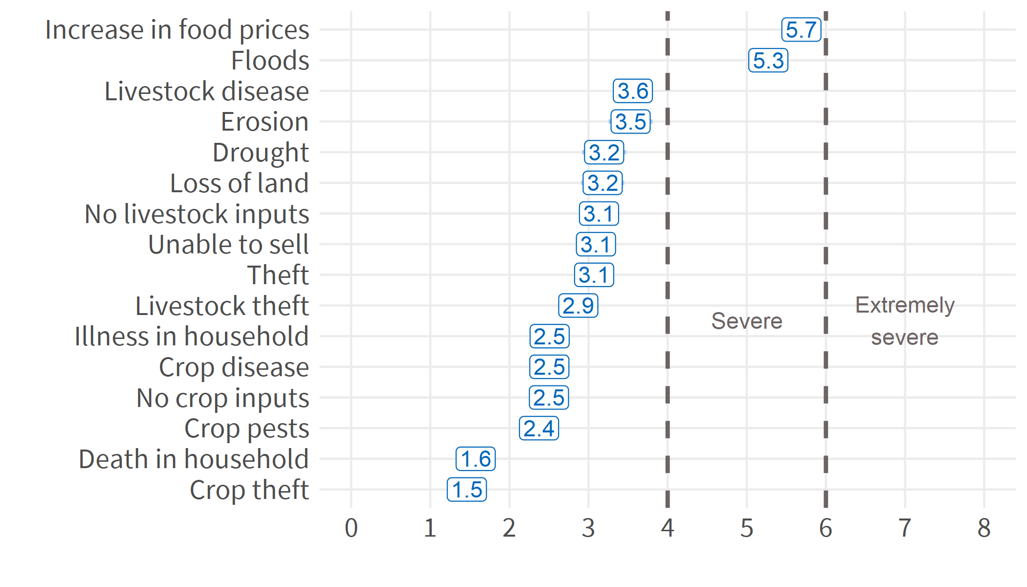
SHOCKS AND STRESSES Shock severity (0-8)
Notes:
“Thinking of the past 12 months, did your household face difficult times as a result of ____________ ?”
“How severe would you say the impact of ____________ was on your household’s economic situation?”
“How severe would you say the impact of ____________ was on your household’s food consumption?”

Slide 18
SHOCKS AND STRESSES
Shock exposure index map – study counties are colored by their mean value score with the top 2 shocks highlighted per county

Slide 19
STRESSES (CONFLICT)
38%
In previous 6 months
Incidence of conflict
Types of conflict
Key Takeaways
Water, cattle/revenge killing, and gender-based violence the most common types of conflict
Cattle raiding/revenge killing the most damaging conflicts
Majority of disputes resolved by elders or through dialogue
Disputants satisfied with elders’ mediation in 1/3 of cases

Slide 20

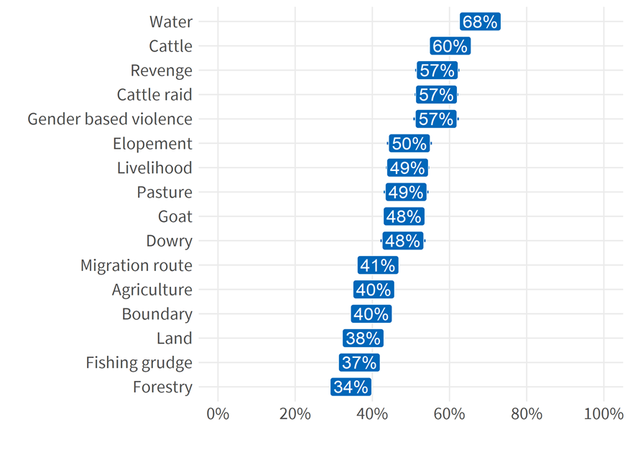
STRESSES (CONFLICT)
Water most common conflict
Second tier of conflicts regard cattle, revenge, and gender-based violence
Cattle-raiding and revenge were most damaging conflicts to households

Slide 21
SHOCKS AND STRESSES Types of conflict across county
Overall reported conflict types:
Water (68%)
Cattle (60%)
SGBV (57%)
Survey counties map – top 2 reported conflict types per county
Notes:
Conflict over water is most common, but localized to Uror and Wau
Conflict over cattle, raids, and revenge are more distributed more widely across counties

Slide 22
“Two important elements of resilience that the Mission will focus on, as contextualized to South Sudan, are agency and social cohesion, both of which are linked to social inequities and typically have an inverse relationship to conflict and trauma.”
Mission strategy
SOCIAL
COHESION
39
(0-100)
Bonding Social Capital
Bridging Social Capital
43.3
34.6
Key Takeaways
Achieving mutual-aid relationships with non-relatives within villages more critical for cohesion than achieving mutual-aid relationships with relatives across villages
Bonding social capital easier to achieve than bridging social capital

Slide 23
SOCIAL COHESION Bonding and Bridging Social Capital
Leer only county where bridging social capital higher than bonding social capital
Biggest disparities in Pibor and Akobo

Slide 24
“Aspirational thinking about one’s future is critical to stopping the negative coping mechanisms to environmental and man-made shocks that foster aid-dependency.” -Mission PMP
AGENCY
74.1
(0-100 scale)
Aspirations
Locus of Control
76.6
71.4
Key Takeaways
Households are generally optimistic in their future outlook
Aspirations for future increases as exposure to shocks/conflict increases

Slide 25
SOCIAL NORMS
Perception of SGBV
Acceptance of Cattle Raiding
Opinions of Educating Girls
Early Marriage
Key Takeaways
91% of households stated support for girls’ education
75% acceptance of cattle raiding justified as revenge
73% acceptance of early marriage justified by economic pressure
61% acceptance of sexual and gender-based violence justified by household conflicts
Shocks and conflict associated with increased support for harmful practices, while education associated with reduced support

Slide 26
COPING STRATEGIES
RESILIENCE
-
Dietary Change
Rationing Strategies
Decrease Numbers of People
Sale of productive assets
Shocks / Stresses
RESILIENCE OUTCOMES (Ability to recover, food insecurity)
Resilience Capacities
+
Notes:
From Tango 2008 Methods “Field Methods Manual Second Edition January 2008”
Figure 1. A List of Coping Strategies
Dietary Change:
Rely on less preferred and less expensive foods
Increase Short-Term Household Food Availability:
Borrow food from a friend or relative
Purchase food on credit
Gather wild food, hunt, or harvest immature crops
Consume seed stock held for next season
Decrease Numbers of People:
Send children to eat with neighbors
Send household members to beg
Rationing Strategies:
Limit portion size at mealtimes
Restrict consumption by adults in order for small children to eat
Feed working members of HH at the expense of non-working members
Reduce number of meals eaten in a day
Skip entire days without eating

Slide 27
RESILIENCE Absorptive resilience capacity
Absorptive | Survey item(s) | Value
Availability of informal safety nets | Group membership | 35.2
Bonding social capital | Mutual aid within community | 43.3
Access to remittances | Income source | 5.7%
Shock preparedness | Early warning systems | 35.2
Shock preparedness | Emergency action plans | 19.2
Access to humanitarian assistance | Aware of donor activity | 44.3%
Overall absorptive capacity |  | 32.5

Slide 28
RESILIENCE Absorptive Resilience Capacity
HIGHEST:
Pibor (51)
Kapoeta North (45)
LOWEST:
Jur River (21)
Wau (18)

Slide 29
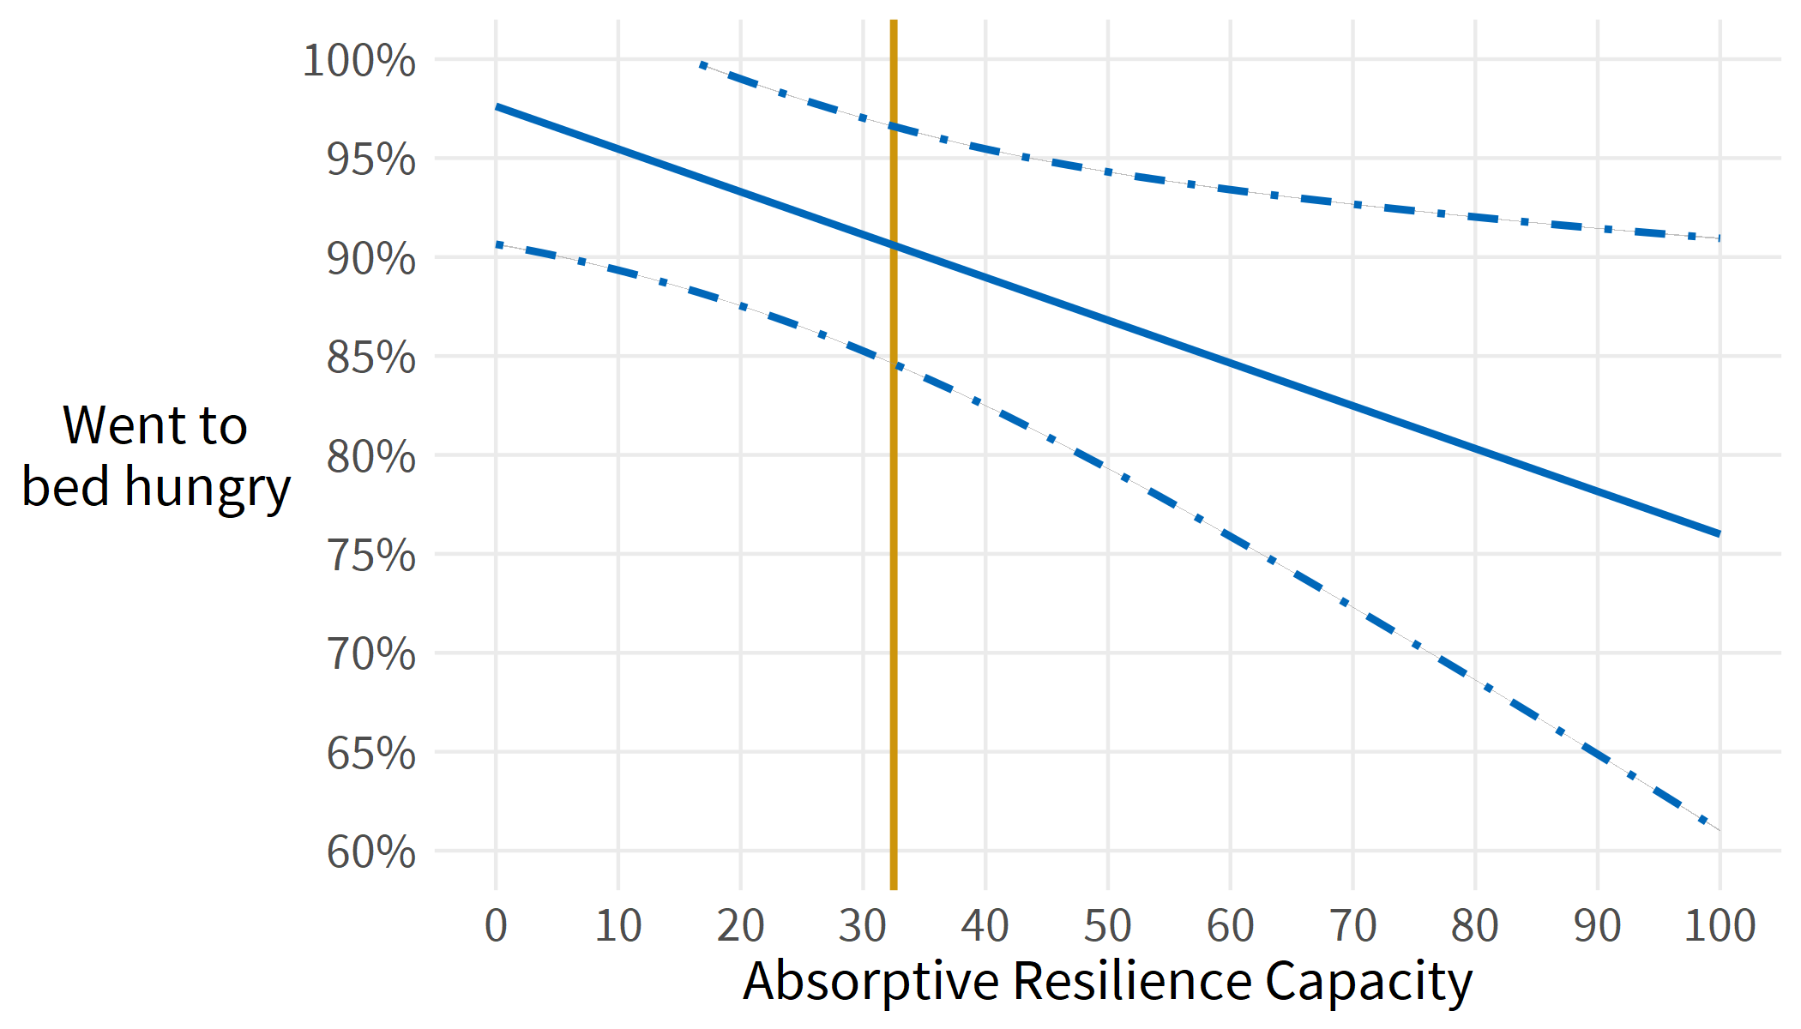
RESILIENCE Higher absorptive capacity reduces food insecurity
88% of household reported going to bed hungry in past 30 days
Absorptive resilience capacity in priority counties is 32.5 on a 0-100 scale
Improving absorptive capacity by 20 points is associated with a reduction in food insecurity by 5.8 percentage points
Notes:
After controlling for shocks, conflict, household size, head of household sex, and county:
A one standard deviation increase in absorptive capacity (about 20 on 0-100 scale) predicts a .37 sd increase in ability to recover (about .52)
That would bring ability to recover from 3.6 to 4.1

Slide 30
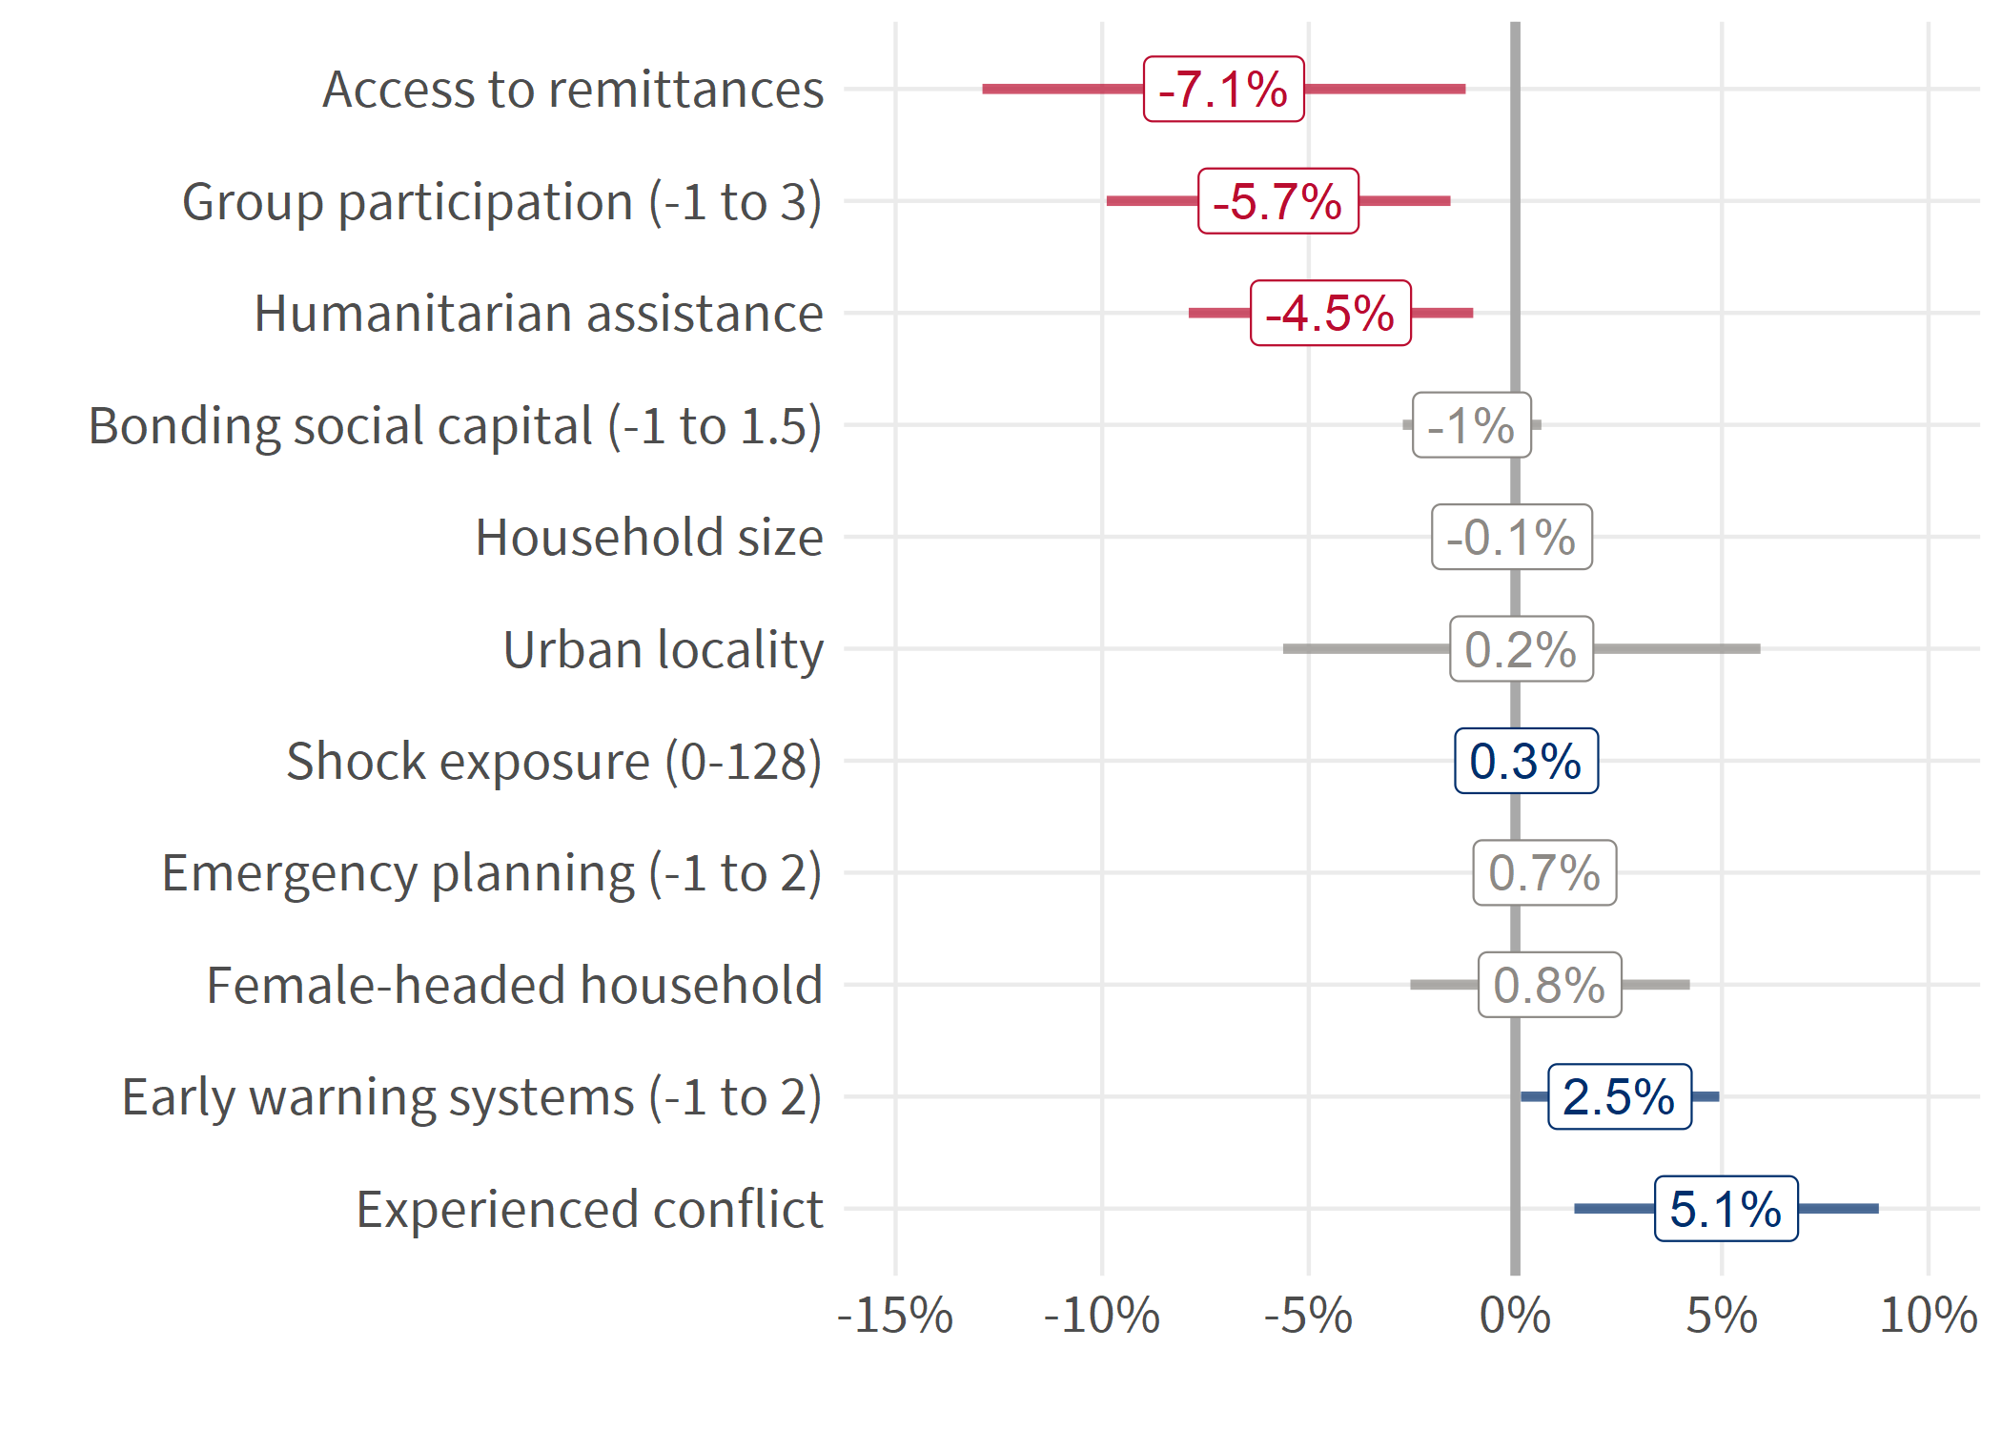
RESILIENCE Disaggregates of absorptive capacity and food insecurity
Donor activity in the community is associated with a 4.5 percentage point reduction in food insecurity
Group participation associated with lower food insecurity, but may reflect a more permissive environment
Early warning systems associated with an increase in food insecurity, but this may reflect the targeting of plans to areas of highest need
Notes:
After controlling for shocks, conflict, and county:
A one standard deviation increase in absorptive capacity (about 20 on 0-100 scale) predicts a .37 sd increase in ability to recover (about .52)
That would bring ability to recover from 3.6 to 4.1

Slide 31

DISCUSSION

Slide 32
Summary of Findings/Conclusions
USAID/South Sudan has a valid baseline to measure its 2020-2024 strategy
USAID/South Sudan has additional baseline measures on resilience capacities
Increases in resilience capacity were associated with improvements in well-being outcomes (ability to recover from shocks, food insecurity)
Food security a better outcome measure of humanitarian assistance outcomes than dietary diversity
Resilience capacity measures (agency, cohesion) tended to be higher in areas with higher incidence of shocks and conflict, and could therefore be considered a form of coping strategy

Slide 33
Suggestions for consideration
Conduct follow-up studies to examine relationships between resilience capacities, coping strategies, and subsequent well-being
disparities in bonding and bridging social capital
additional social norms information (i.e., education, household power distribution, food access, informal safety nets)
Collect additional data on food security, coping strategies
Add food security as a PMP indicator if feasible
Incorporate outcome monitoring into beneficiary surveys

Slide 34

Thank you!
For more information about this baseline, please contact the South Sudan MESP team.
Source: MESP Field team picture of a deserted EA in Mayendit.
Notes:
Oct. 14, 2021 – Field MESP team picture
deserted EAs in Mayendit

Slide 35
STOP
END PRESENTATION

Slide 36
ADDITIONAL SLIDES
Supporting slides for the main slide deck.

Slide 37
RESILIENCE Index construction
Food for thought
TANGO (2018) relies on index variables that are the sum of a set of survey items. An index that is the simple sum of its constituent items means that each item carries the same weight in its contribution to the index – a strong and often unwarranted assumption
Factor analytic routines examine the correlation structure of a set of items and properly weight each item according to its unique information content.
Index variables from factor analysis can be rescaled to a range from 0-100 to help with interpretability and reporting
Notes:
The assumption is that each item contributes unique information relative to all other items, and the amount of this unique information is also the same as all other items (equal weights).

Slide 38
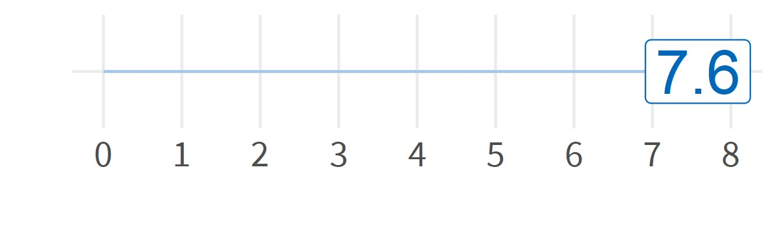
FOOD SECURITY – Food Insecurity Experience Scale (FIES)
90.2% of households report severe food insecurity
Mean scale value 7.6
Mild |  |  | Moderate |  |  | Severe
1 | 2 | 3 | 4 | 5 | 6 | 7 | 8
Worried about not enough to eat | Unable to eat healthy | Reduced dietary diversity | Skipped a meal | Ate less than needed | No food in household | Did not eat | Went a day without eating
94.7% | 94.8% | 94.9% | 94.4% | 95.2% | 94.7% | 94.7% | 94%

Slide 39
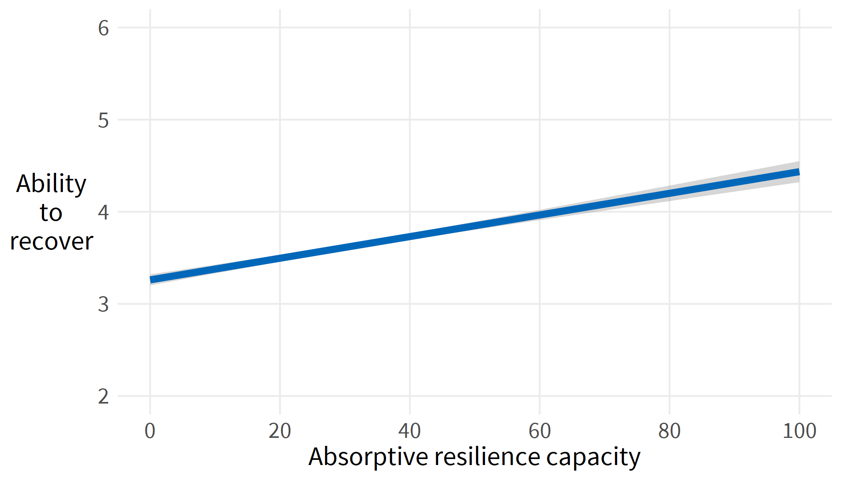
RESILIENCE Higher absorptive capacity leads to greater ability to recover
Notes:
After controlling for shocks, conflict, and county:
A one standard deviation increase in absorptive capacity (about 20 on 0-100 scale) predicts a .37 sd increase in ability to recover (about .52)
That would bring ability to recover from 3.6 to 4.1

Slide 40
RESILIENCE What is it?
Resilience is the ability to handle shocks
Resilience is measured both as an outcome (food security, ability to recover from shocks), and as a capacity (absorptive, adaptive, transformative)
Development Objective 2
Household Resilience Increased in Targeted Areas
“If USAID is intentional in layering and sequencing development assistance in 13 target counties intended to diversify diets, improve food security and nutrition, and address basic health and education outcomes, then household resilience will be increased, and these beneficiaries should need less humanitarian assistance in the future when encountered by shock.”
Notes:
one of the biggest issues in the litature is how its defined, how the models are relative to location and context, and thus how comparisons are difficult...also another key point, the "social variables" oftne omitted due to difficulty in data capture and costs, are showing signs (in various peer studies) that they matter as much or more to the tangible variables (social capital, income assets, etc.) finally..the literature also states, CAUSAL IEs are few showing the impact of interventions on resilience.

Slide 41
SOCIAL COHESION Index
Food for thought
The current instrument measures social cohesion in terms of mutual aid across relatives / non-relatives, and within / across villages
Additional measures for incorporation into social cohesion could be considered
Collective action within / between villages
Generalized trust across social or ethnic divides

Slide 42
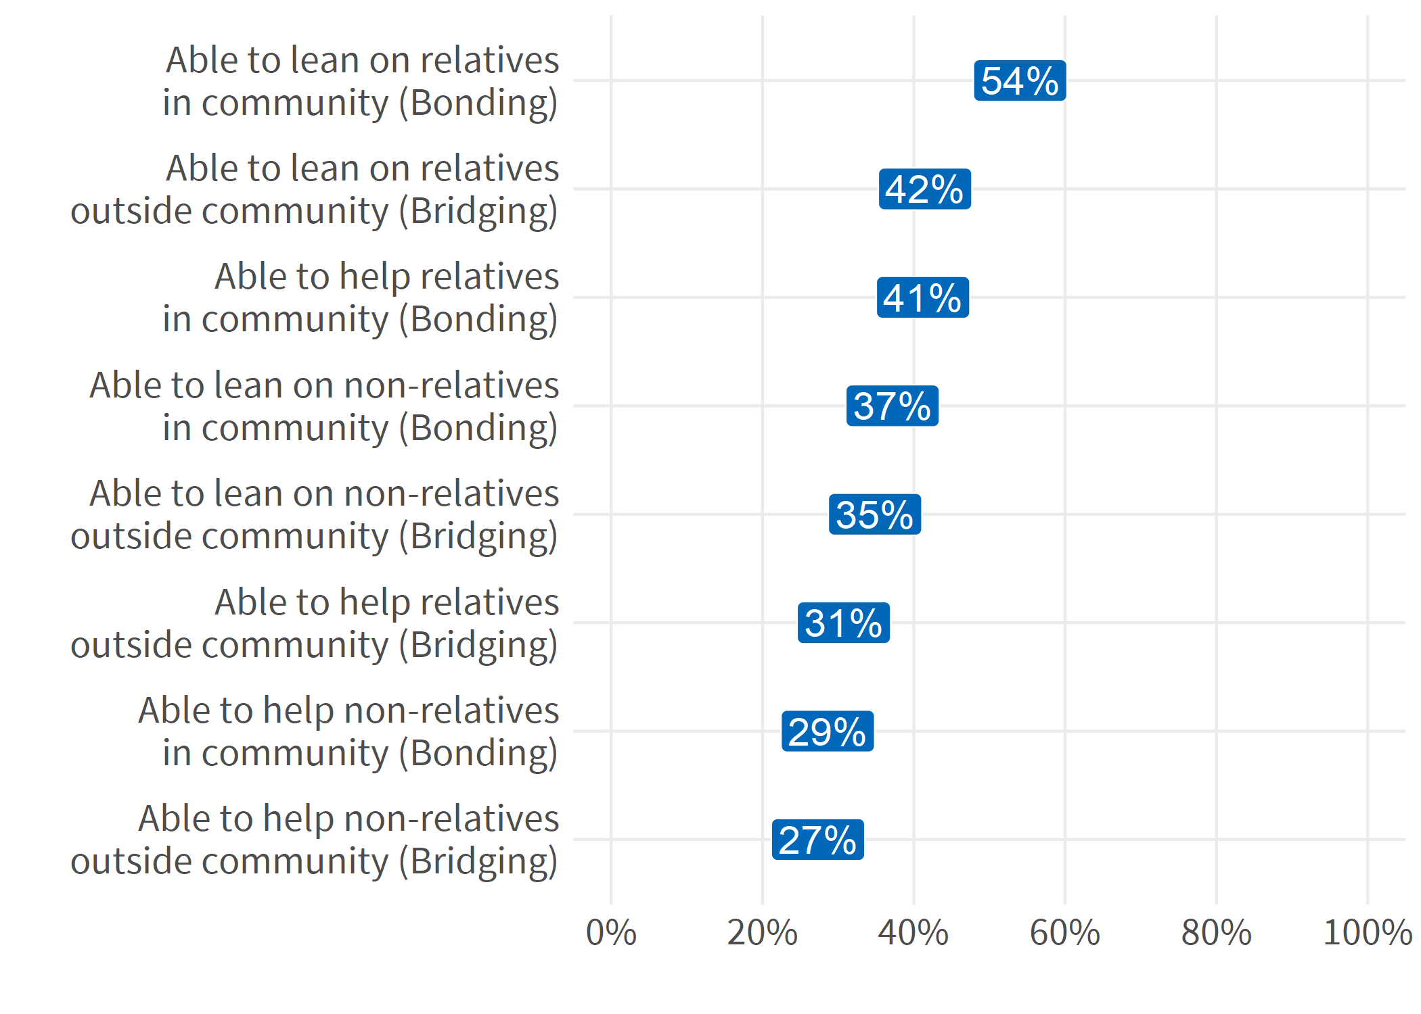
SOCIAL COHESION Bonding and Bridging Index items
BONDING
Mutual support within communities
Ability to lean on non-relatives in community has highest discrimination
BRIDGING
Mutual support across communities
Ability to lean on relatives outside community has highest discrimination

Slide 43
ASPIRATIONS Index
Food for thought
Following TANGO (2018), the resilience baseline includes a related index measuring the perceived locus of control. Given some internal / construct validity concerns about the aspirations index, incorporation of the locus of control index could improve data quality.
Better understanding is needed of households’ aspirations window, in which some future needs are perceived as reasonably attainable, while other future needs are not (Rao et al 2020; Ray 2006).

Slide 44
SOCIAL COHESION Index
Food for thought
Surveying in the USAID priority counties provides the critical baseline measures of need
Surveying only the most critical areas might make it more difficult to document change (see food security)
Expanding data collection to an additional 4-6 counties may help provide crucial context against which to assess changes in USAID priority counties
Notes:
There are evaluation design issues inherent to these comments. Without comparison counties, implicit assumption is that we want to look for changes across all priority counties.
However, the mission strategy references target payams within the priority counties. These payams must be identified in order to help document changes in the indicator values over time.

Slide 45
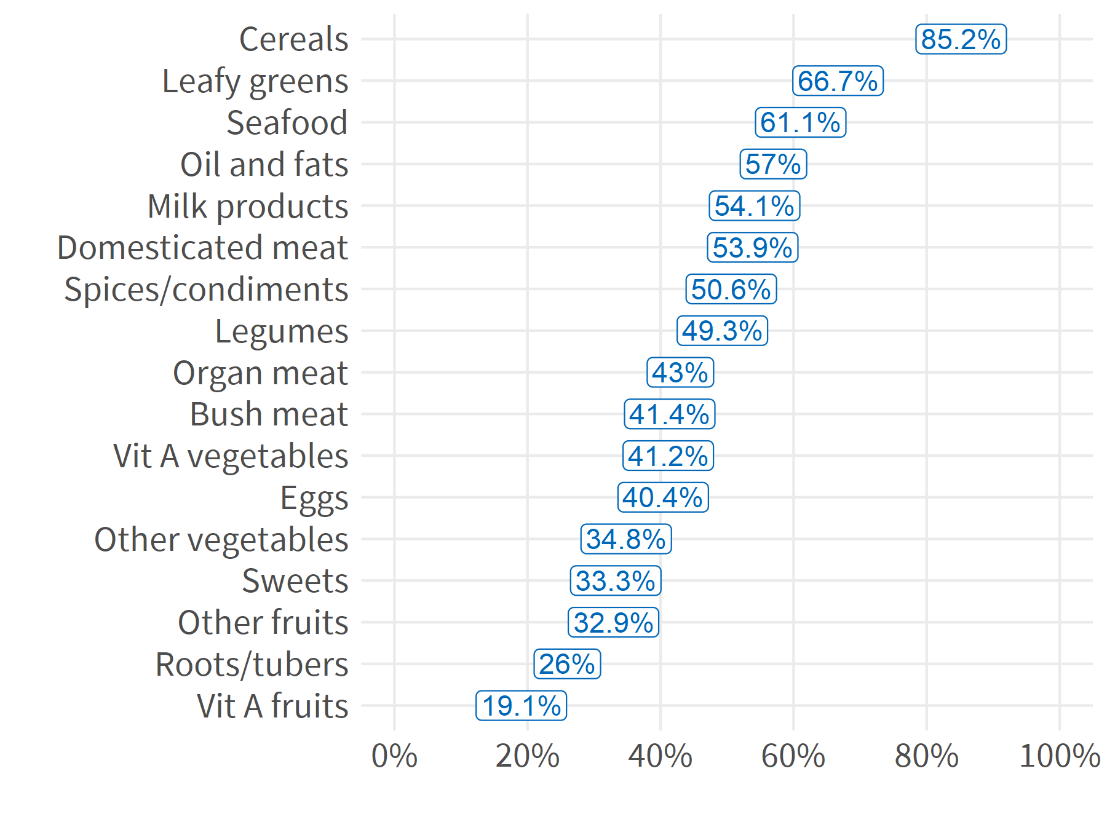
FOOD SECURITY Most common foods in household diet
Consumption of any meat is the best indicator that the household also has a high overall dietary diversity
.
Notes:
Eating fish seems driven by responses in Akobo, Baliet, Duk, Leer, Mayendit, Paynijar, Pibor, Ulang, and Wau
Statistically Significant Correlations with HDDS
Locality: Positive. Urban areas correlated with higher HDDS.
Household size: Negative. Larger households correlated with lower HDDS.
Shock exposure: Positive. More shocks correlated with higher HDDS.
Group participation. Positive. Participating in social groups correlated with higher HDDS.

Slide 46
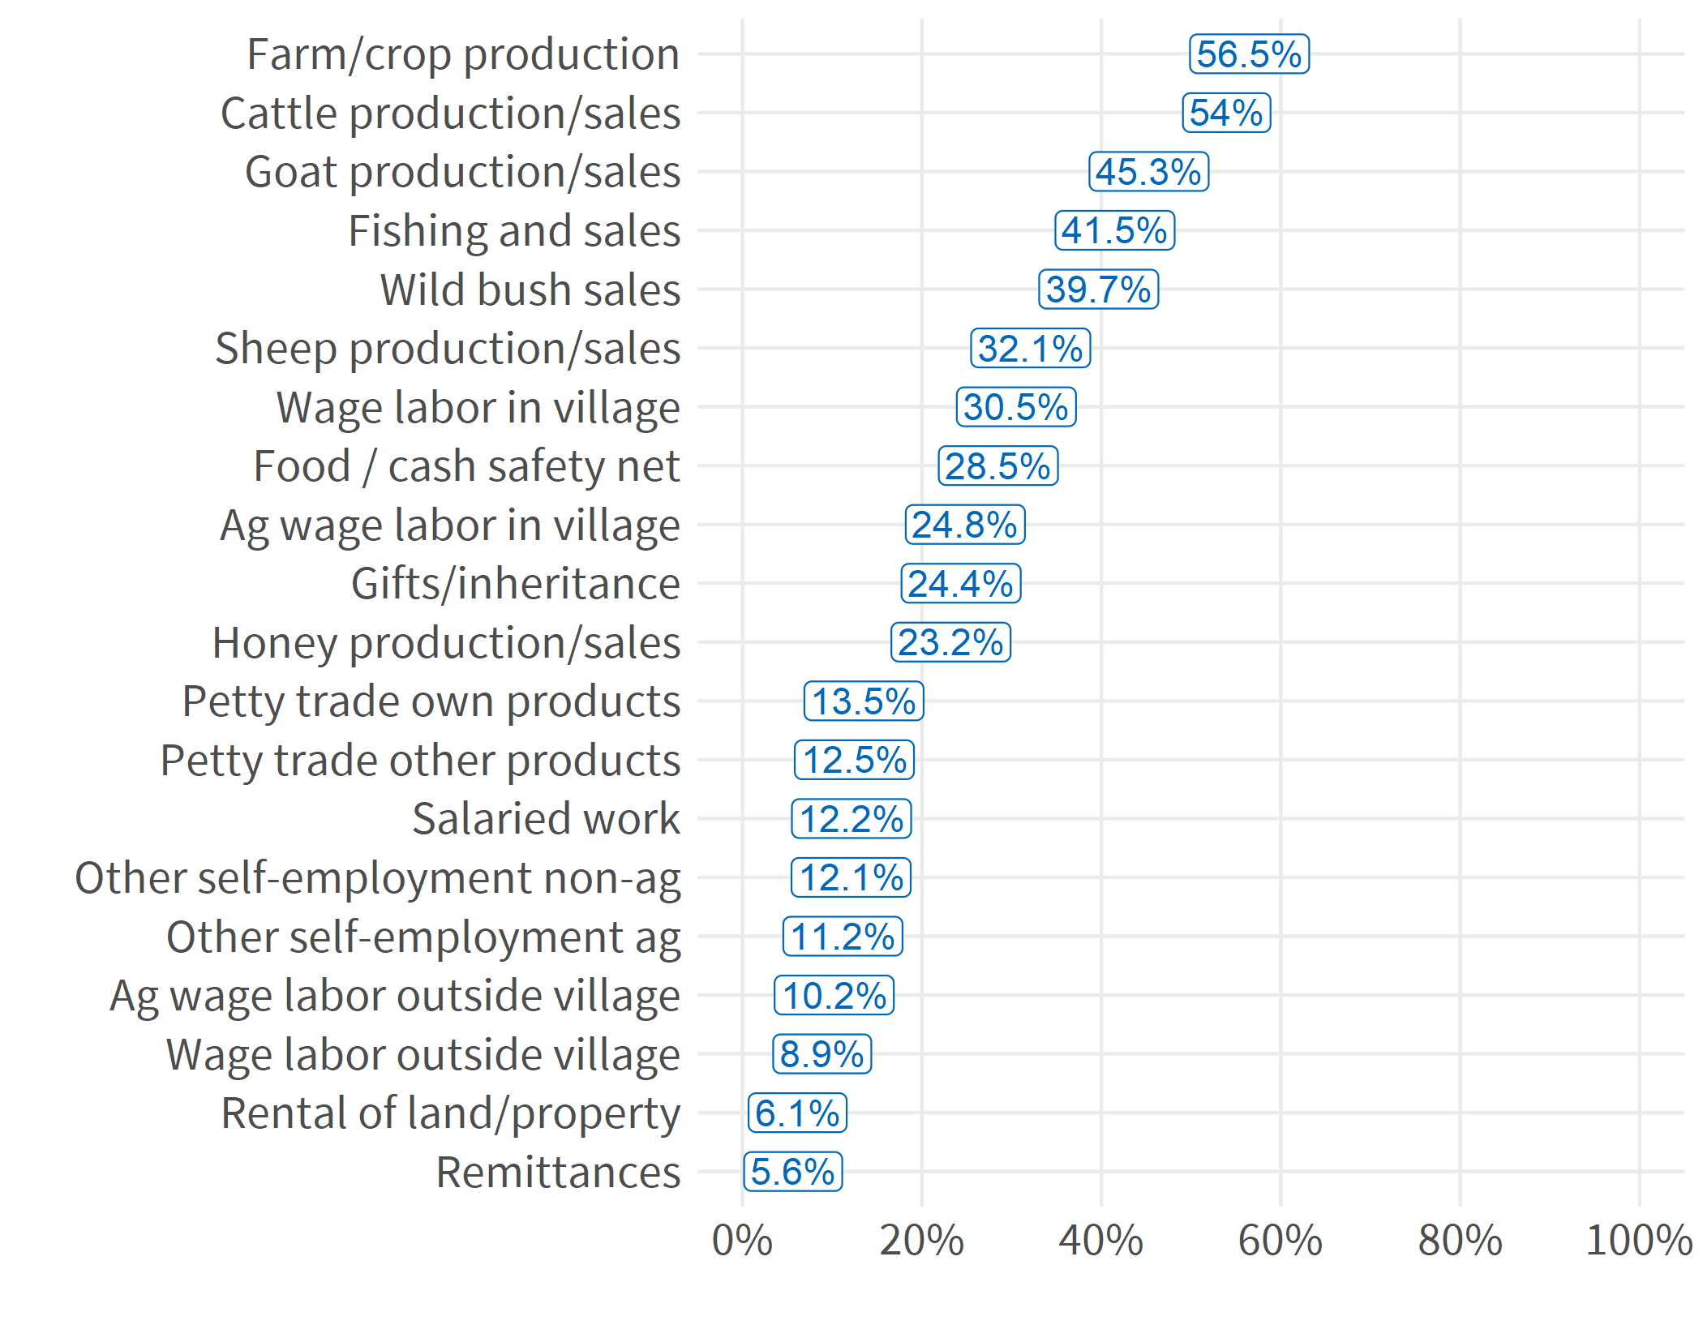
Survey demographics Household income sources
.

